Slide 1
Global Sourcing
Quote Request Process

Slide 2
Included in Presentation
  Quoting Process and why it needed to be improved
  Accessing DARTboard
  RFQ Process Flowchart
  Request Process Including
    RFQ Workbook – Excel Download thru DARTboard
    Accessing the forms on DARTboard

Slide 3
Why we need an RFQ process
Easy Submission of information required to process an effective RFQ
Complete overview of open quotes and status
Centralized quoting process to leverage spend across current and new suppliers

Slide 4


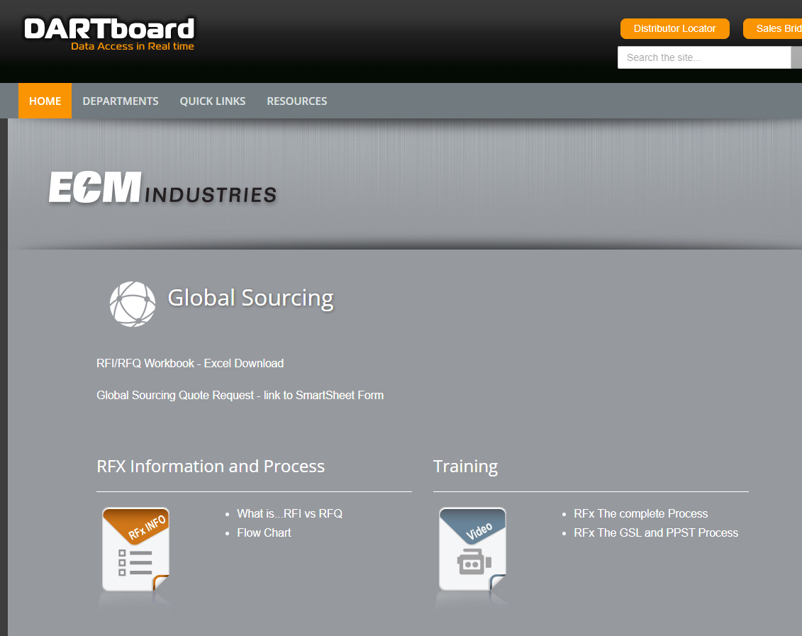
Accessing DARTboard
Must access thru Microsoft Edge
In MS Edge Browser type in http://dartboard.ecmops.com/
Click on Dartpartments/Global Sourcing – you will see page shown at left

Slide 5
RFQ Requirements
    RFQ
      Minimum Information Requirement
        Item Number
        Item Description
        Estimated annual usage or Forecasted Usage if new item
        Drawing, Specifications, relevant information that you may have on requirements

Slide 6
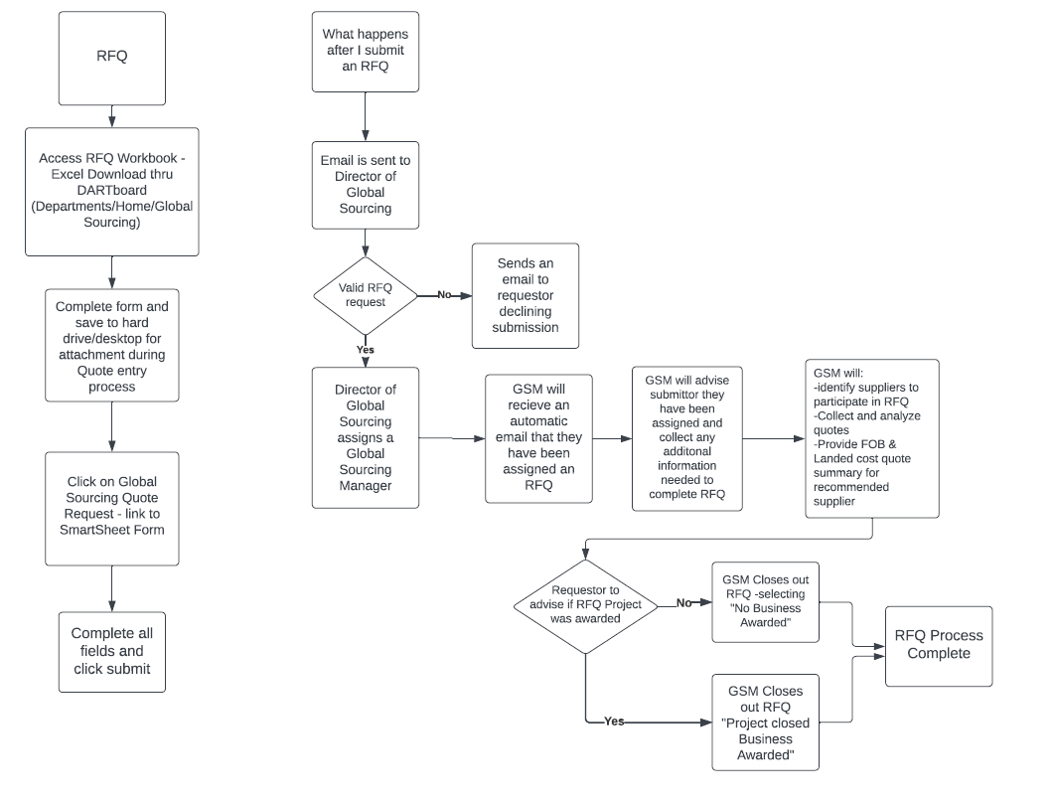
RFQ Flowchart

Slide 7
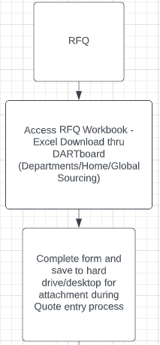
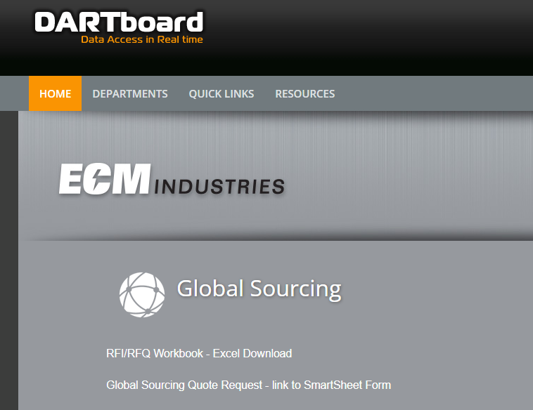
RFQ ENTRY

Slide 8
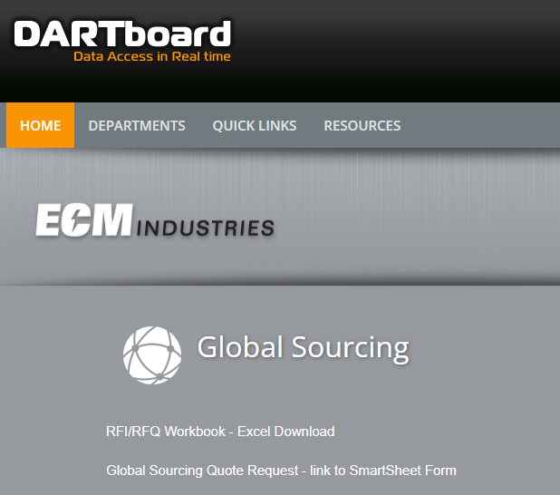
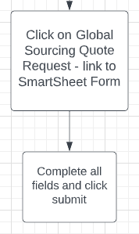
Accessing Request Form

Slide 9
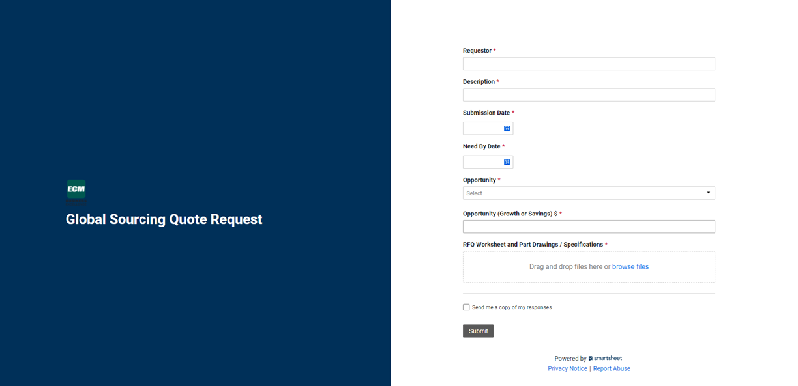
Global Sourcing Quote Request Online Form

Slide 10
Opportunity Field
When you click on the down arrow under Opportunity you must choose from the following:
    RFI (request for Information)
    Competitive Intelligence
    Cost Down
    NPD-OEM
    NPD-Retail/Distribution
    Line Review
    Engineering Change
    Supplier Risk/Performance

Slide 11
Opportunity (Growth / Savings / Risk)
All projects, regardless of department, are prioritized based on risk and/or savings to the company
    NPD – forecasted sales
    Growth – forecasted sales
    Savings – Potential savings by moving to new supplier
    Risk – Sales $$ of finished goods at risk

Slide 12
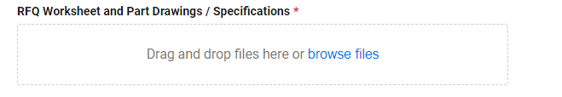

Attachments and Submitting
Drag and drop the RFQ Workbook that you completed and saved to computer
Click to receive an email copy of the submission

Slide 13
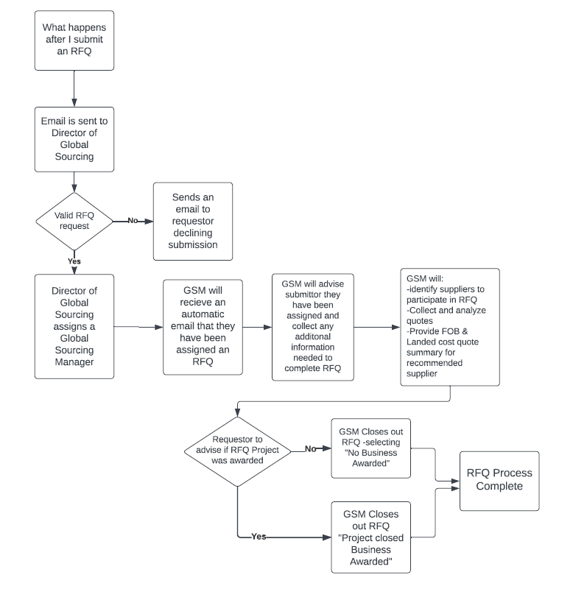
After Submitting the RFQ

Slide 14
Thank you

